Slide 1
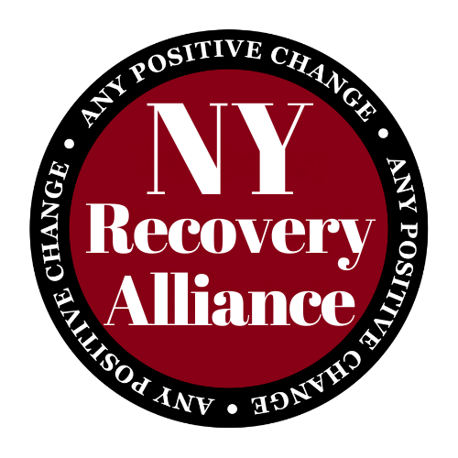
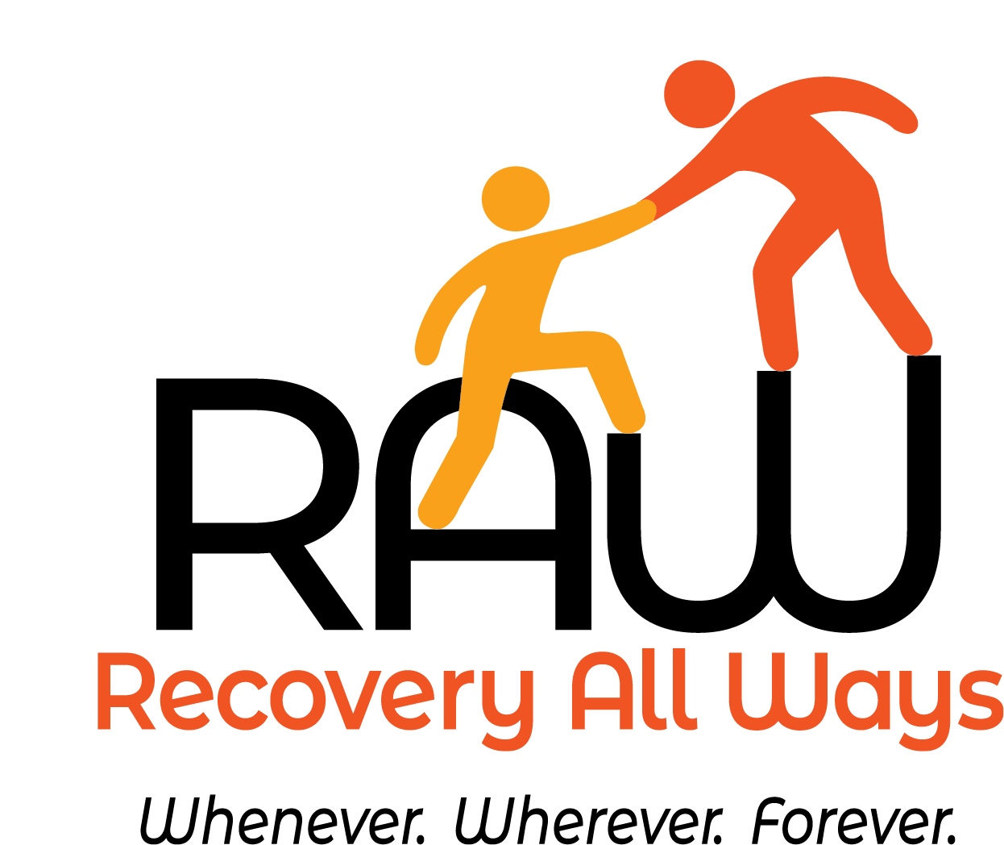
NALOXONE TRAINING
Thank You For Attending Our
Notes:
Pre-test – this is to show that you did not know enough before your took the class.
Post Test – If you get 90% or more, you will be certified to distribute Naloxone and to train others.
Who I am: A person in recovery
I say this because its important to reduce the stigma around addiction.
Stigma has a deep impact on the rate of people dying. It can prevent people from wanting to use naxlone.n
Harm Reduction: Our main priority is public health.
Spectrum of recovery from rince your works all the way to abstience.
Thank you for coming.
We have a chance to stop people from dying from overdoses.

Slide 2
Goals Of Training
RAW - NYRA - Harm Reduction
Identify Opiate Overdoses
Identify Risk Factors
Reduce Chances of OD
Identify Common Opiates
What is Naloxone?
How To Administer Naloxone
Review
So What Is The IRA ?

Slide 3
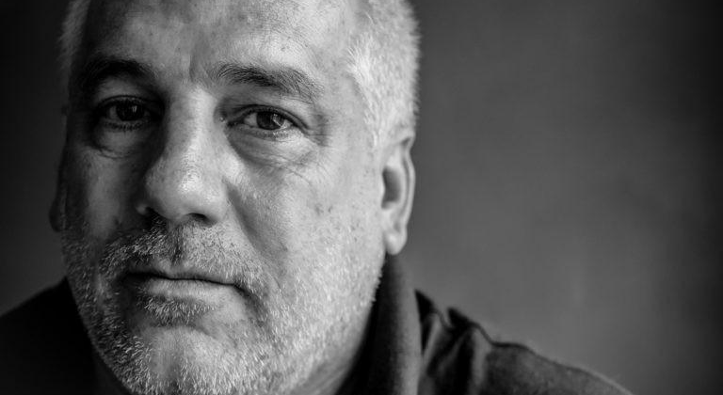
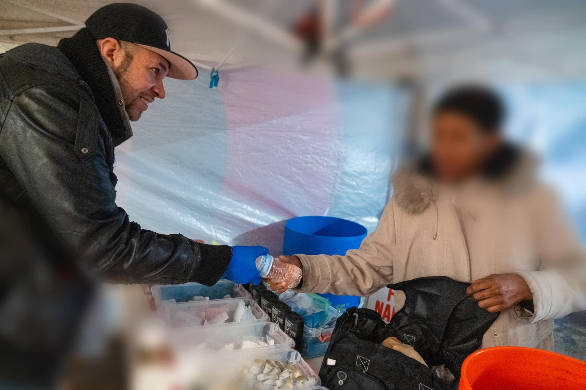
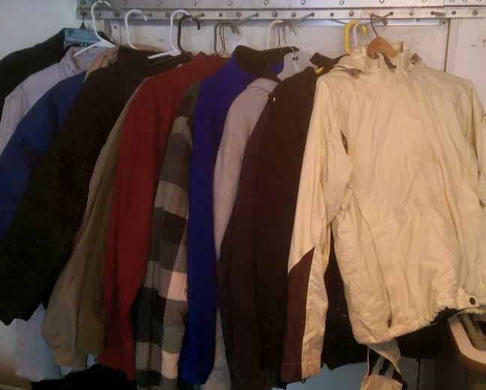
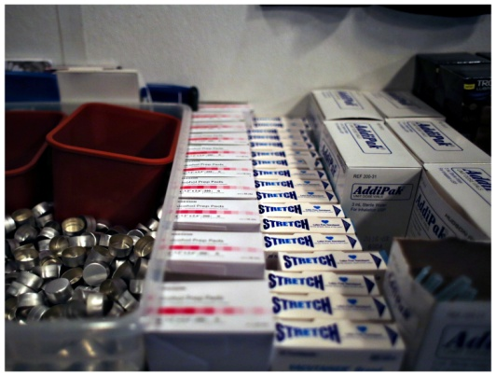
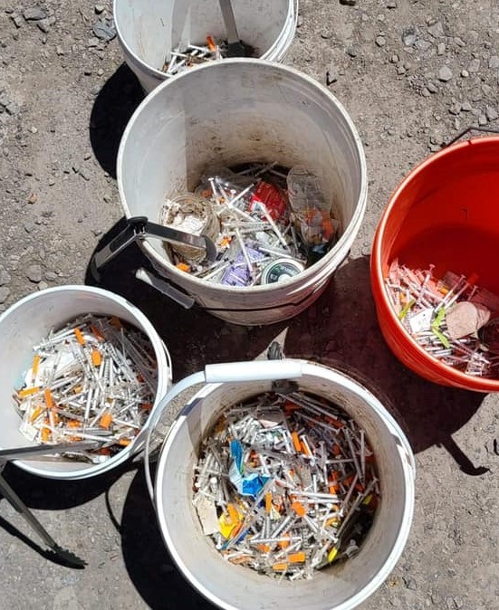
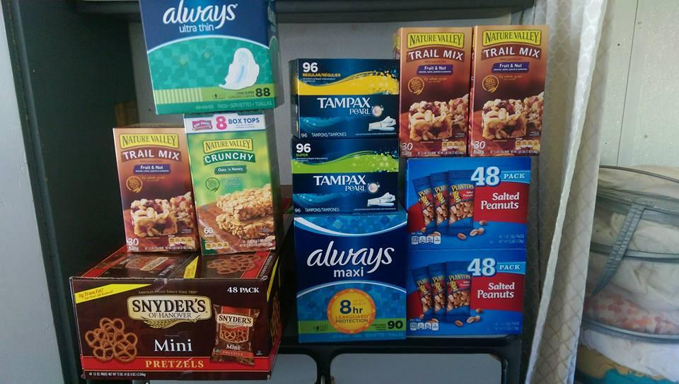
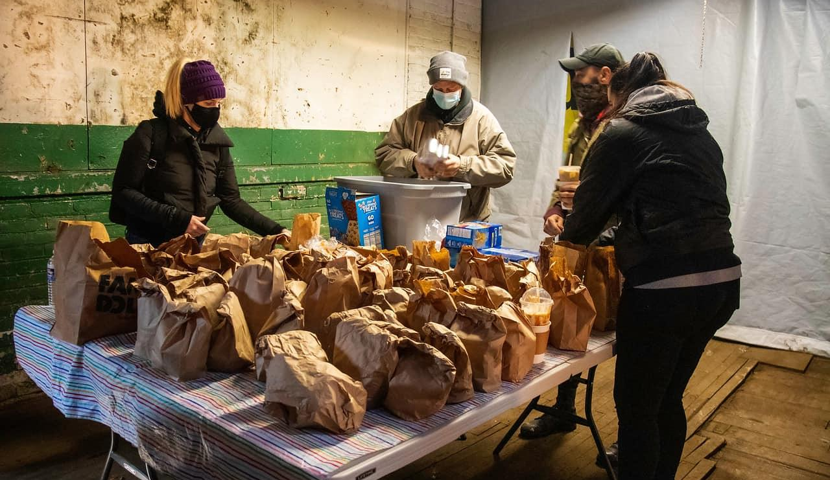
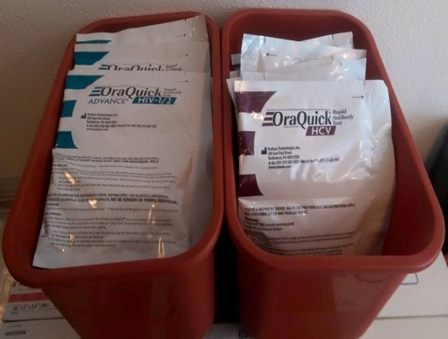
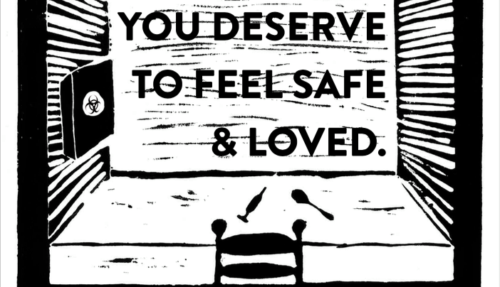
Narcan, RAW and NYRA
Notes:
former and current IV drug users, renegade social workers and public health folks, sex workers and some churches
We were in a garage about a year ago.
bikes and trailers, tiny amount of supplies
Scott County and a new reality for Indiana Harm Reduction
Registered as Nalxone entity
Needle exchange
Three things we must do to give out naloxone:
1. Offer a treatment referral
2. Train on how to identify an OD and administer naloxone
3. instruct to call 911
100k worth of suppliesk
A truck
60+ volunteers
We’ve given out about 300 doses of naloxone (As of 12/19/15)
Done some trainings – overdose lifeline
Law changed because someone who was a neighbor of Senator _______ whose son died of an overdose.
We have had some powerful experiences on the van…

Slide 4
Our Harm Reduction Program
Who Are We?
HR Values:
Grassroots
Non-profit
All volunteer
Participant-Driven
Non-coercive
Any Positive Change
Education
Advocacy
Food, Clothes, Supplies
Love
Direct Action
Impacted People Lead
Respect Dignity
Voluntary Association
Autonomy
Empowerment
Meet people where they are
Enough About The IRA…

Slide 5
Overdose is the leading cause
of accidental death among adults in the United States.
932,000 Lives Lost since 1999.
Physiology

Slide 6
The Physiology Of An Overdose
After you ingest opiates, opiate receptors in brain are filled
Depressed breathing results
The more of the drug taken, the more breathing becomes depressed to the point of not breathing at all (overdose)
More than 5 minutes of not breathing could lead to permanent brain damage
Rescue breathing will keep a person alive
An Important Point:
Notes:
One of the affects of opiates on the receptiors is the euphoria. If the receptors are too filled, then you stop breathing.
Example of

Slide 7
RESCUE BREATHING
DURING
AN OPIATE OD
CAN SAVE A LIFE
Signs Of Overdose?
Notes:
As long as you keep breathing for the person, you can save them.
You can keep doing that for hours
That gives you time to prepare to make a call – clean things up, give people with warrants a chance to leave…

Slide 8
Signs Of An
Opiate Overdose
Notes:
Awake, unable to talk
Limp body
Pale, clammy face
Lips, fingernails blue
Slow, erratic breathing
Stopped breathing
Choking sounds
Vomiting
Loss of consciousness
Foaming or frothing at the mouth
Tiny pupils
Unresponsive to outside stimulus
Yell “The cops are here!”
STERNAL RUB

Slide 9
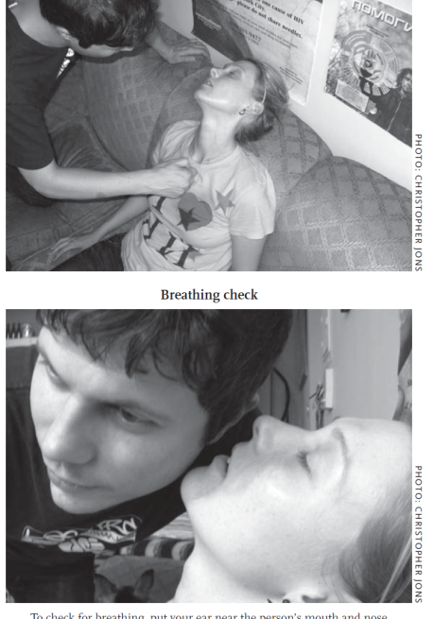
How To Identify An OD
Awake but unable to talk
Body is very limp
Face is pale, clammy
Lips, fingernails skin blue for lighter skinned people
Lips, fingernails turn gray for darker skinned people
Breathing is very slow, erratic or has stopped
Choking or gurgling sounds
Vomiting, foaming
Loss of consciousness
Unresponsive to outside stimulus?
Do a sternal rub!
Risks Increasing OD?

Slide 10
Risk Factors
of an Overdose
Notes:
Been clean (as little as three days)
Mixing with other drugs
Tolerance
Type of drug/potency
Using alone
Age and physical health
Mode of administration
Previous, non-fatal OD

Slide 11
Increased Risk of Overdose
Low Tolerance (being abstinent for as little as three days)
Mixing with other drugs (Either uppers or downers)
Type of drug / potency
Using alone (Stigma)
Age and physical health
Previous, non-fatal OD
Confusion
Old age
Mode of administration (snort, oral, skin pop, muscle, vein)
Shame and stigma kill
Prevent Overdoses?

Slide 12
Reducing the Chance of an Opiate Overdose
Notes:
Education
Sober Sitter
Have naloxone on hand
Don’t mix drugs
Educate on OD prevention
Don’t use alone
Partner Agreement Checklist
“Taste” the shot
Use less if tolerance is low
Don’t use opiates

Slide 13
Preventing Fatal Overdoses
Carry naloxone
Don’t mix drugs
Educate on OD prevention
Know Your Source
Don’t Use Alone
Sober sitter
Never Use Alone
“Taste” the shot
Don’t use opiates
Test drugs for fentanyl
Partner Agreement Checklist
Use less if tolerance is low
What Is A Partner Agreement Checklist?

Slide 14
Partner Agreement Checklist
Knows OD prevention practices
Knows if and when you want them to call 911 / go to ER
Knows if, when and how you want them to use naloxone
Has agreed to stay with you for support
Knows your commitment to not use again while you wait for naloxone to wear off
Tell Them That:

Slide 15
RESCUE BREATHING
DURING AN
OPIATE OD
CAN SAVE A LIFE
Head Tilt / Chin Lift / Pinch Nose / Breath every 5 Seconds
What is Naloxone?

Slide 16
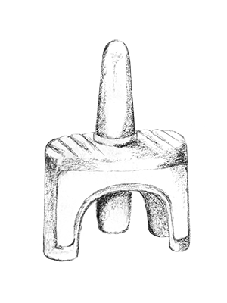
WHAT IS NALOXONE?
Opiate Overdose Reversal Drug
that’s it
just that
nothing else
Naloxone and Narcan are the same drug
Why Can The IRA Distribute Naloxone?

Slide 17
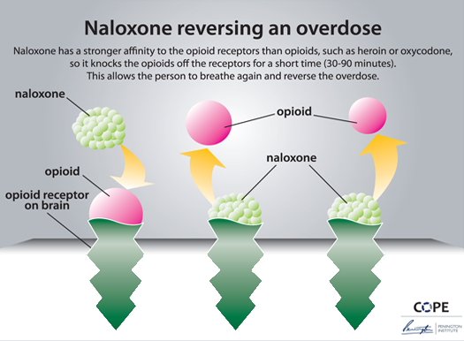
How Does Naloxone Work?
Antagonist
Stronger affinity for receptors
Kicks opiates out for up to 90 mins
Allows resumption of breathing
No euphoria
Many ways to administer
IV fastest
intramuscular
subcutaneous slowest, but longest lasting
Works on ALL opiates
What ‘s That Look Like?
Notes:
Agnoist: Suboxone, Methadone – Just a different form of the opiate, but less intoxicating.
Antagonist: Blocks the receptors – No capacity to produce intoxication.
That means that someone who has a high tolerance can get dope sick with sudden withdrawal symptoms.

Slide 18
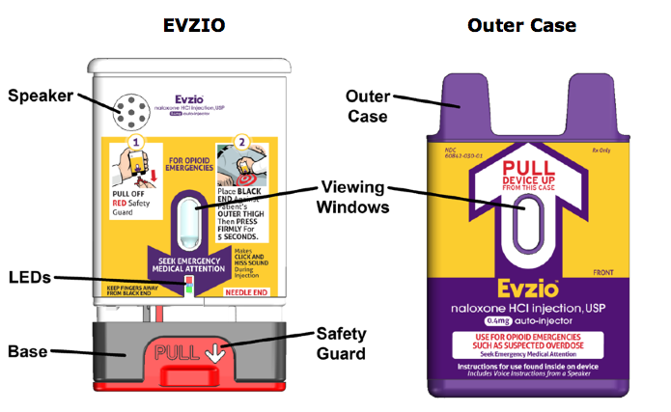
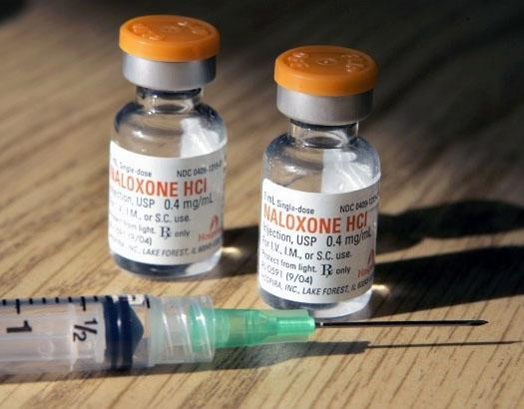
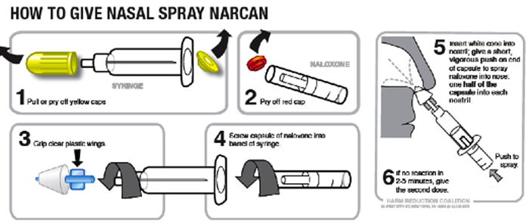
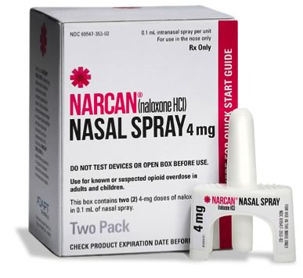
Different Forms Of Naloxone
What are common opiates?
Notes:
$760 for Evzio auto injector
$ 100 for two doses intranasal
$30 for UK injectable
$15 for IRA naloxone
new under the tongue would be available soon
Can use insurance co-pay if ever prescribed an opiate

Slide 19
Common Opiates

Slide 20
Naloxone ONLY works on Opiates
Opiates
NOT 0piates
Heroin
Opana
Vicodin
Tylenol 3
Percocet
Fentanyl
Morphine
Suboxone
Oxycontin
Methadone
Hydrocodone
Demerol
Cocaine
DMX
Spice
Alcohol
Antihistamine
Benzodiazepine
Methamphetamine
Xylazine
Should I use Naloxone If I’m Not Sure What They’ve Taken?

Slide 21
Use Naloxone Even If You Aren’t Sure Opiates Are Involved
Naloxone is relatively harmless
Only reverses opiate overdose
Does not interact with other illicit drugs
Take opiates out of equation
Fentanyl contamination of non-opioids is occurring
Is Naloxone Safe?

Slide 22
Naloxone Is Very Safe
used when delivering babies if too much sedative administered
not known to interact with other drugs
invented in 1961
FDA approved in 1971
no potential for misuse
we could safely inject or ingest it right now

Slide 23
Keeping the Naloxone Safe
Keep out of direct sunlight (IM)
Keep it above freezing
Keep it under 80 degrees
Notice the expiration, then add 20 years!

Slide 24
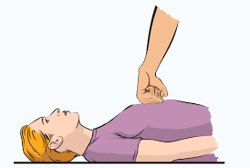
Stimulate and Call for Help
Sternal Rub
If the person is not responsive
Call 911
Tell them your friend is not breathing

Slide 25
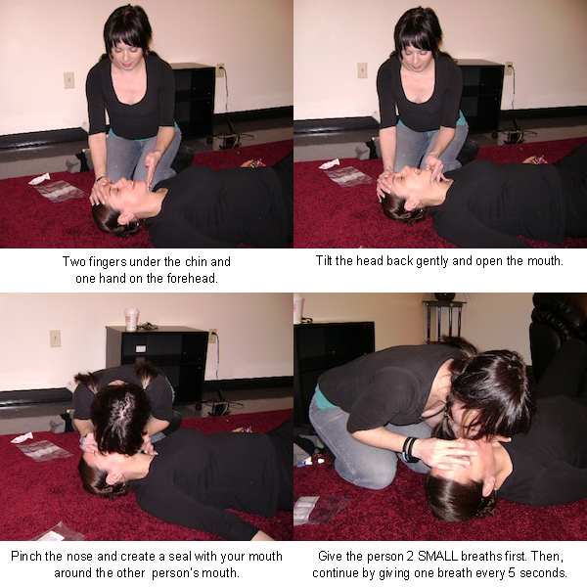
A and B of Life
Airway and Breathing
Roll on back
Clear airway
Tilt head
Pinch Nose
2 quick breaths
1 big breath every 5-7 seconds
Watch the chest to make sure it rises & falls
Don’t forget…

Slide 26
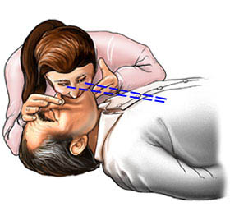
RESCUE BREATHING
DURING AN
OPIATE OD
CAN SAVE A LIFE
Head Tilt / Chin Lift / Pinch Nose / Breath every 5 Second

Slide 27
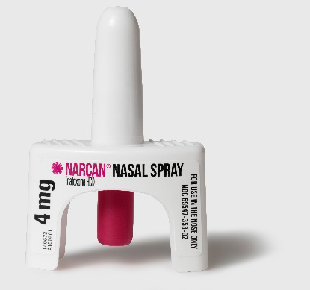
Evaluate and Administer Spray
Are they better?
Can you get naloxone quick enough for them so they don’t go too long without assisted breathing?
Place spray up nare
Push the red button

Slide 28
Evaluate and Support
Is the person breathing on their own?
Is another dose needed?
They will feel better in about 15 minutes
90 minutes naloxone will wear off, OD could come back on long acting opioids
Support them and stop them from using again, Naloxone works for 30-90 minutes, so on long lasting opiates (methadone, oxy) overdose may return
RECOVERY POSITION to prevent aspiration
What’s the Recovery Position?

Slide 29
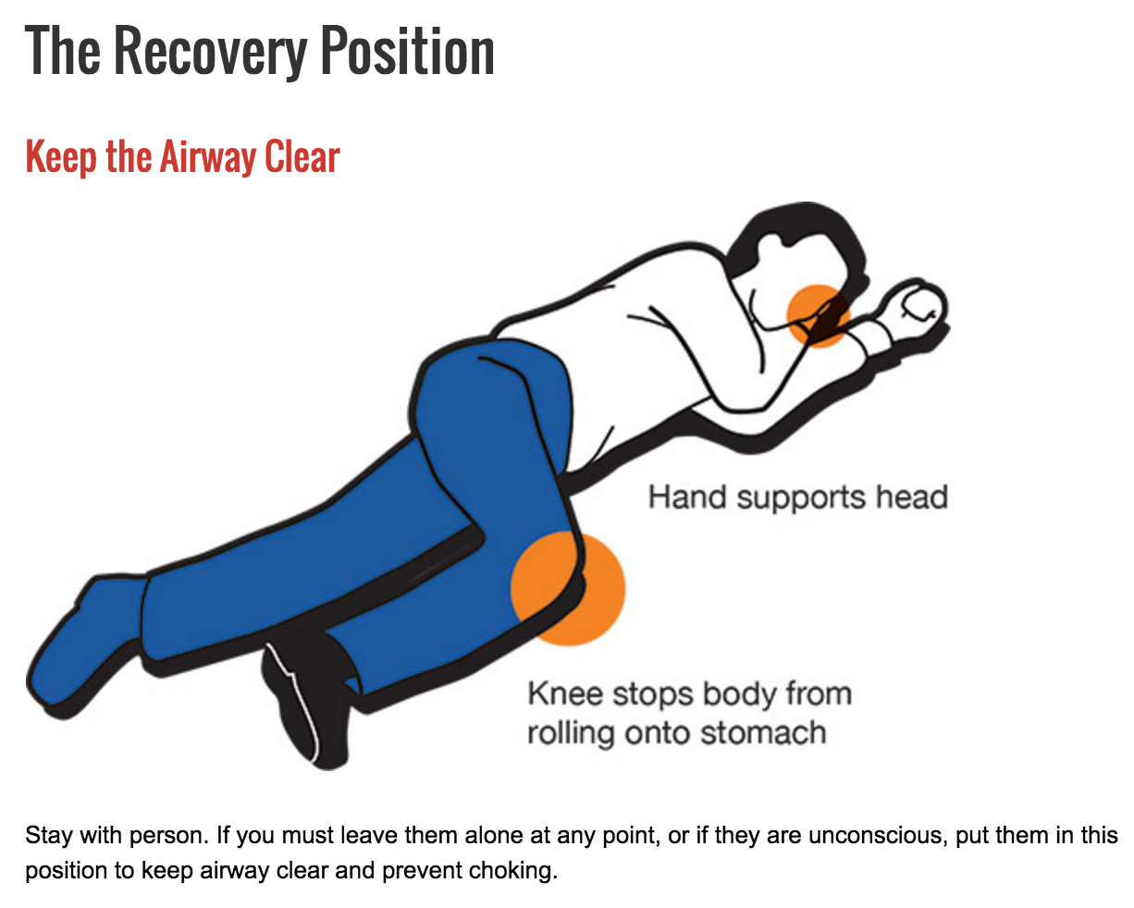

Slide 30
Evaluate and Support
ER uses IV Naloxone with a concentration of 2mg, can cause severe withdrawals
We use Nasal Naloxone with 4 mg
- Much more gentle
- Only a few people have reported vomiting
- Wears off in about 90 minutes
Notes:
What is the difference between Dosage and concentration?

Slide 31
Evaluate
After 5 minutes, are they coming around?
YES: Support them, help them, don’t let them use again
NO: Re-administer naloxone, after 3 doses, make sure you have called 911
One hour later, are they sleepy again?
NO: Watch closely for at least another hour
YES: May need another dose of naloxone

Slide 32
These Techniques Do Not Work If Someone Is Not Breathing
Milk
Salt water
Beat 'em Silly
Ice water
Video time!

Slide 33
RESCUE BREATHING
DURING AN
OPIATE OD
CAN SAVE A LIFE
Head Tilt / Chin Lift / Pinch Nose / Breath every 7 Seconds

Slide 34
Review of what to do:
Stimulate
Call 911
Airway cleared
Rescue Breathing
Evaluate if Naloxone Would Help
Administer Naloxone
Support and Evaluate

Slide 35
It used to be that we talked about overdose in the past tense:
‘I HAD a friend who OD’d.’
Now, overdose is in the present tense:
‘I HAVE a friend who OD’d last week, but it’s OK. He’s all right.”

Slide 36
Where And How To Get Naloxone

Slide 37
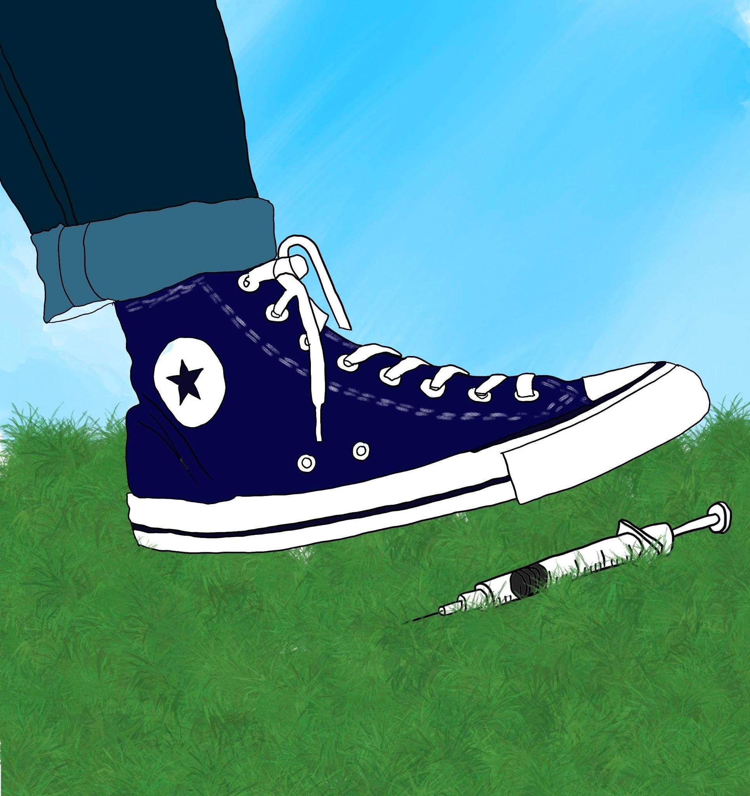
There has NEVER been a case of HIV passed from a community syringe.

Slide 38
Be careful out there,
and let us Know
if we can be
Helpful.
<3

Slide 39
Contact – Volunteer, Get Help, Get Educated
cabert@recoveryallways.org
585-685-9733
@nyrecoveryalliance
nyrecoveryalliance.org
DONATIONS

